Slide 1


Slide 2

Virtual Career fair
KS4 careers fair 2020

Slide 3
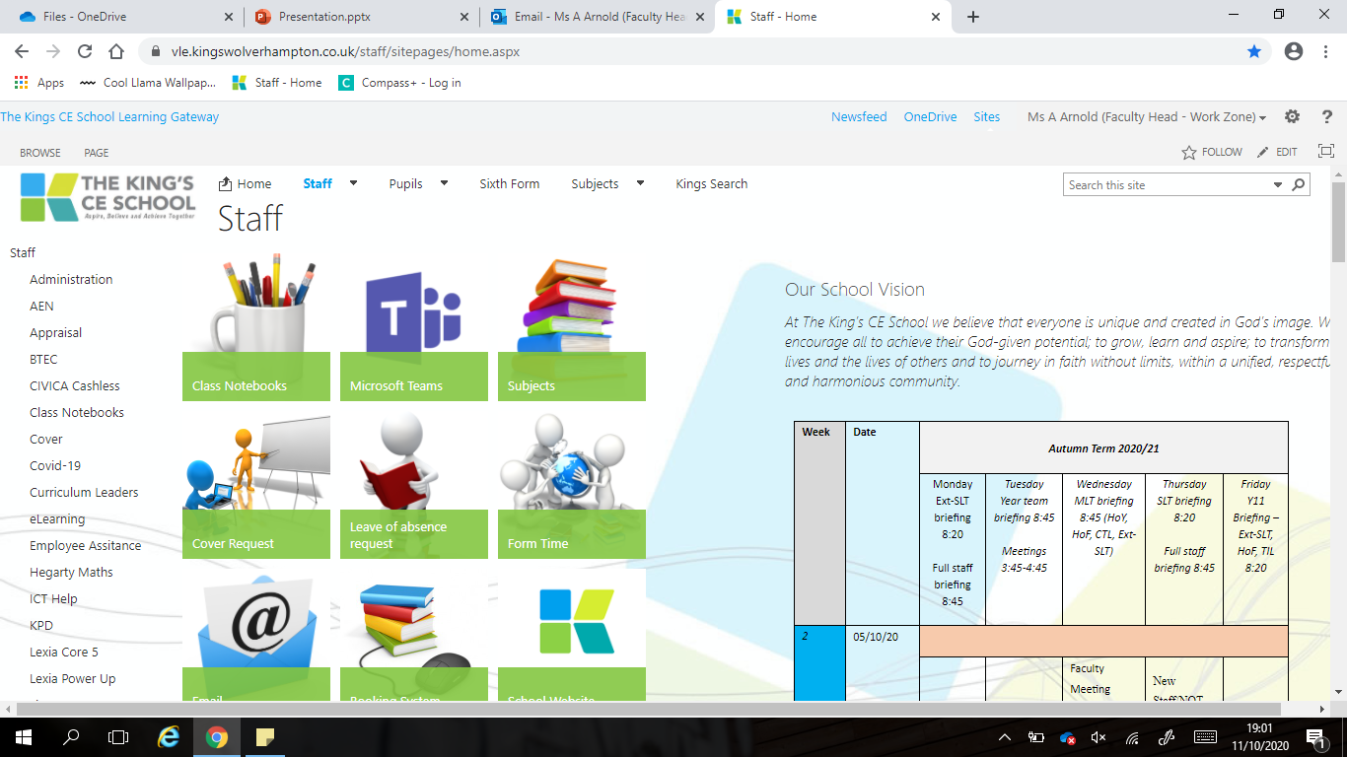
Click 'subjects'

Slide 4
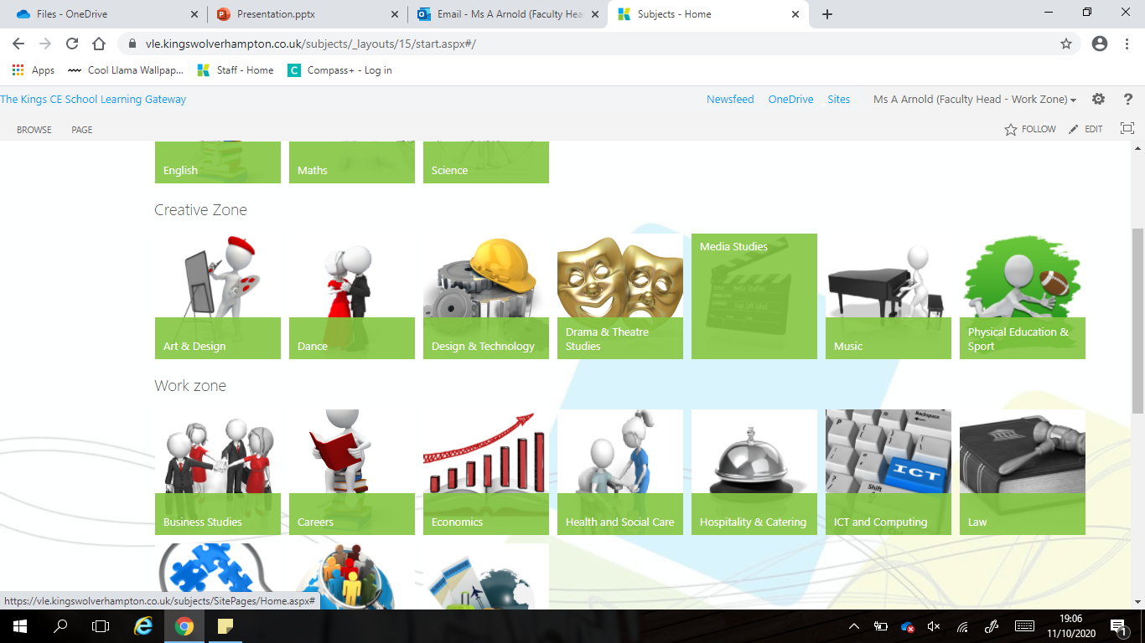
Click 'careers'

Slide 5
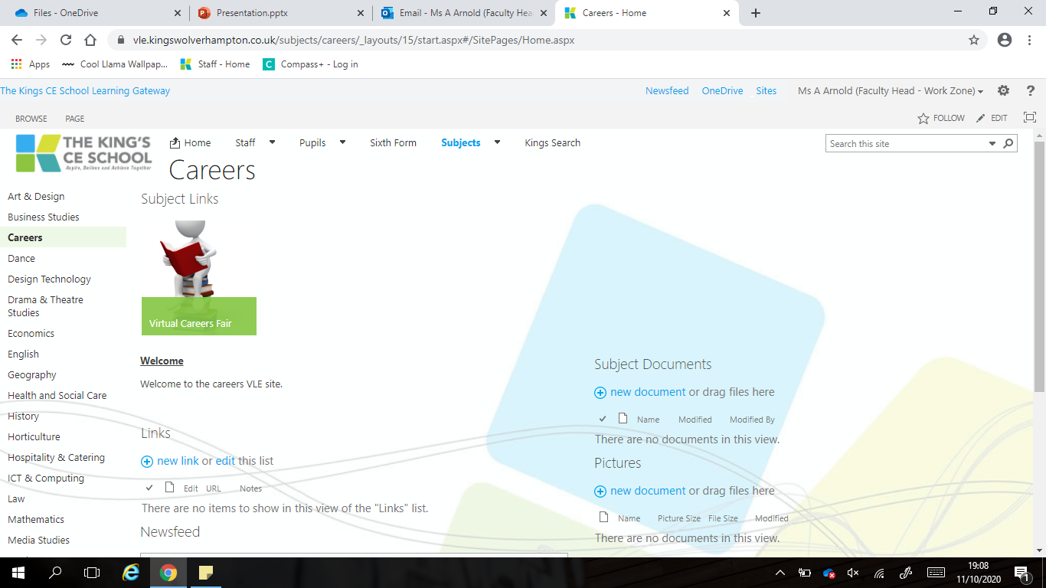
Click 'virtual careers fair'

Slide 6
Student feedback on todays event

