Slide 1



Work Experience Year 12, 1st to 5th July 2024 Year 10, 4th to 6th September 2024
Making the most of work experience 2024
Mrs Thomas – Head of Work Faculty and Careers Lead
"The kingdom of heaven is like a mustard seed... Though it is the smallest of all seeds, yet when it grows, it is the largest of garden plants and becomes a tree, so that the birds come and perch in its branches." Matthew 13 31-32

Slide 2


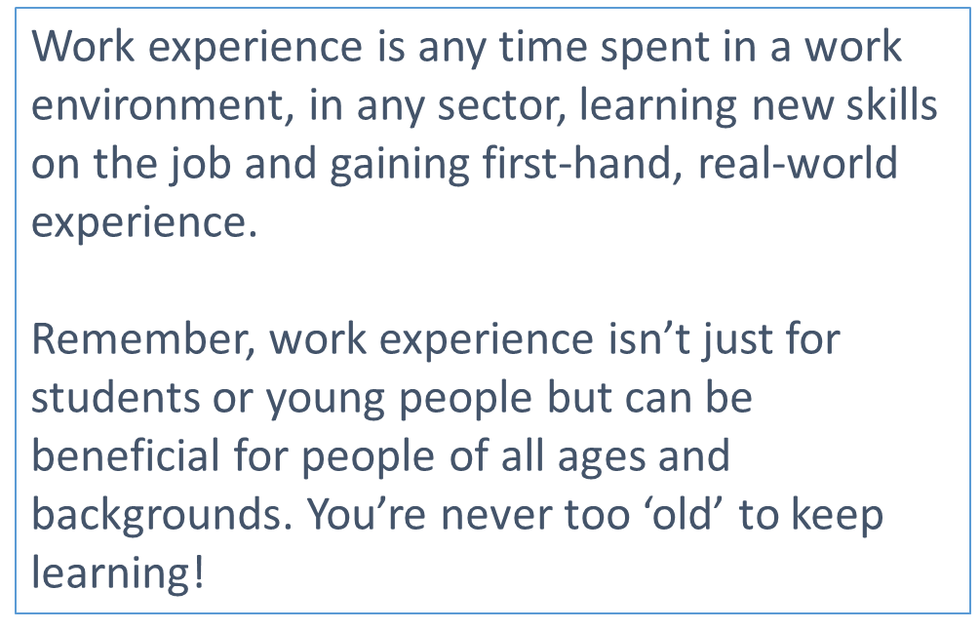
"The kingdom of heaven is like a mustard seed... Though it is the smallest of all seeds, yet when it grows, it is the largest of garden plants and becomes a tree, so that the birds come and perch in its branches." Matthew 13 31-32

Slide 3

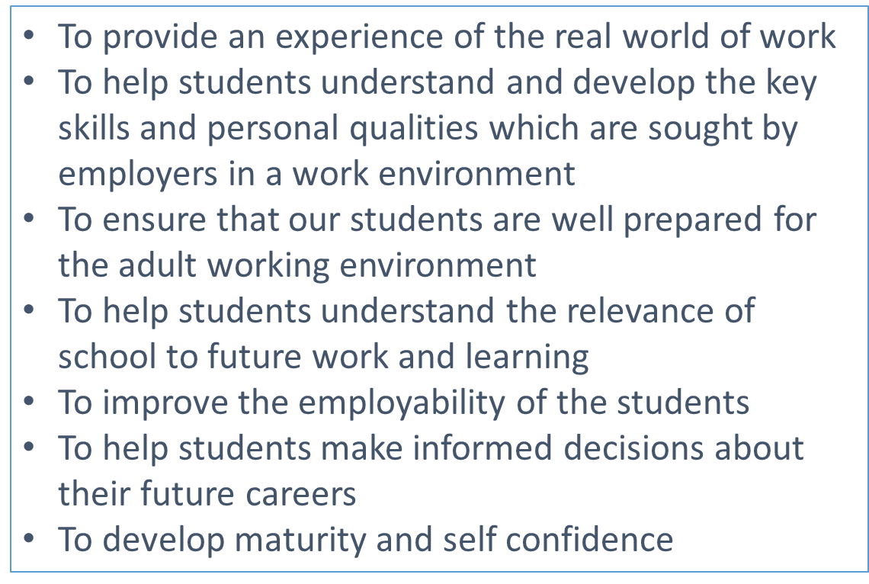
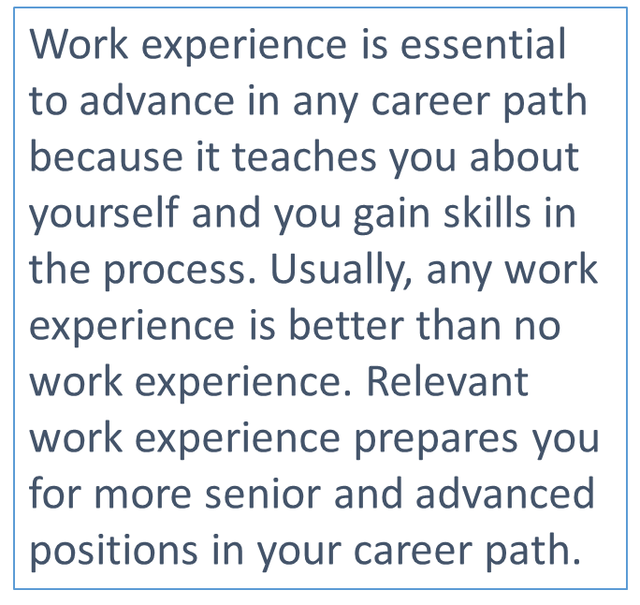
"The kingdom of heaven is like a mustard seed... Though it is the smallest of all seeds, yet when it grows, it is the largest of garden plants and becomes a tree, so that the birds come and perch in its branches." Matthew 13 31-32

Slide 4


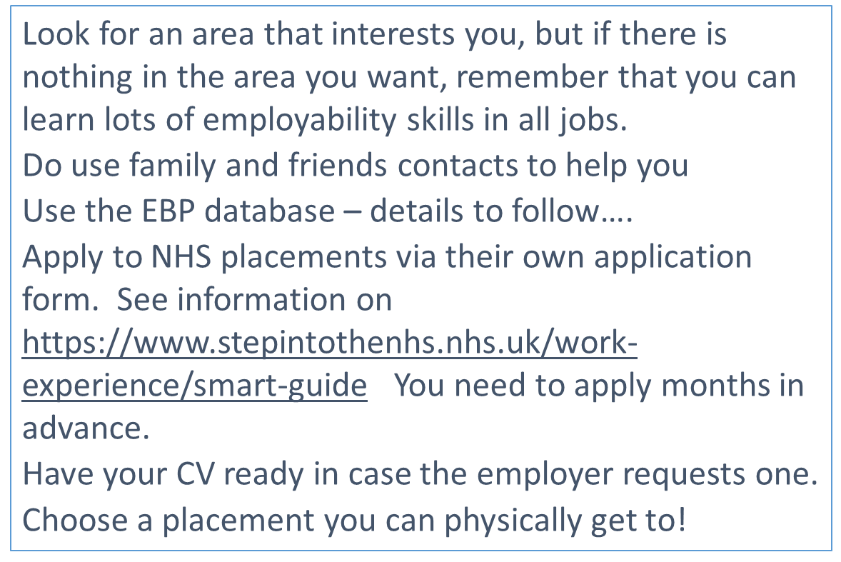
"The kingdom of heaven is like a mustard seed... Though it is the smallest of all seeds, yet when it grows, it is the largest of garden plants and becomes a tree, so that the birds come and perch in its branches." Matthew 13 31-32

Slide 5
How to help your child find a placement
Talk to them about their interests and skills
Talk about what they would like to do in the future
Ask friends and family members who work in an area that they find interesting
Encourage them to start looking straight away!
Sign into the EBP database and have a look at the options available – log-in details will be available soon
Do realise that it can take a while to arrange a placement and that details must be added to the form at the end of this email
Encourage your child to speak to the careers advisor at school
Useful sites for ideas:
https://nationalcareers.service.gov.uk/careers-advice/types-of-work-experience
https://www.prospects.ac.uk/jobs-and-work-experience/work-experience-and-internships
https://www.speakersforschools.org/work-experience-opportunities/
https://barclayslifeskills.com/families/blog/mind-the-gap-making-the-leap-from-school-to-work/
https://www.vodafone.co.uk/newscentre/smart-living/digital-parenting/work-experience-how-to-help-your-child-find-a-useful-placement/
https://successatschool.org/advice/helping-your-child-gain-work-experience/1228
https://thinkstudent.co.uk/ideas-for-work-experience/
"The kingdom of heaven is like a mustard seed... Though it is the smallest of all seeds, yet when it grows, it is the largest of garden plants and becomes a tree, so that the birds come and perch in its branches." Matthew 13 31-32

Slide 6
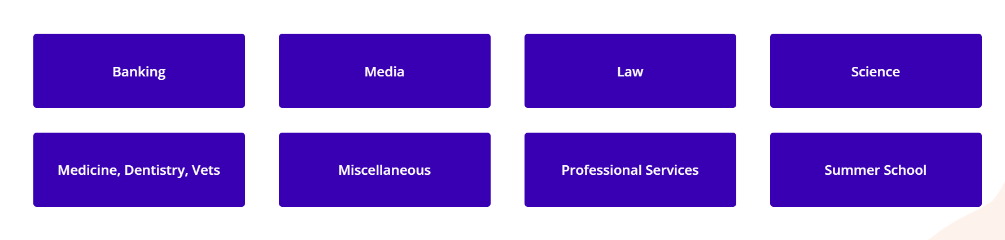
Here are some ideas for year 12 students
"The kingdom of heaven is like a mustard seed... Though it is the smallest of all seeds, yet when it grows, it is the largest of garden plants and becomes a tree, so that the birds come and perch in its branches." Matthew 13 31-32

Slide 7
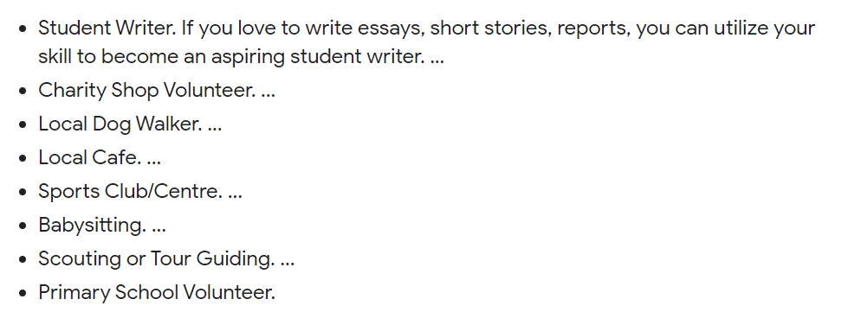
Here are some ideas for year 10 students
"The kingdom of heaven is like a mustard seed... Though it is the smallest of all seeds, yet when it grows, it is the largest of garden plants and becomes a tree, so that the birds come and perch in its branches." Matthew 13 31-32

Slide 8

Students are not allowed to receive any wages whilst on work Experience although employers can offer assistance with lunches and fares if they so wish.
Students are expected to make their own way to and from the placement. Parents are responsible for the travelling expenses and the provision or cost of meals.
Students will be expected to fit in with the general hours of work at their placement as indicated on the placement sheet, not the school day.
Students are expected to attend for the whole period and to arrive punctually each day for work.
If a student is ill or unable to attend the placement for any reason the school and the employer must be contacted by 8.00am on that day.
A letter of confirmation from parents to confirm the absence must be supplied when the student returns to school. If a student does not attend their placement it will be recorded as unauthorised absence or truancy.
It is important that the school and employers are aware of any health or medical issues, which may affect the student during their placement. Please complete a medical consent form if you have a medical issue. Forms can be collected from Mrs Thomas
We expect the very highest standard of behaviour from students at all times during their placement.
Students are expected to dress appropriately for the environment in which they are working. Information about dress code or special clothing will be included in the details provided by the employer.
"The kingdom of heaven is like a mustard seed... Though it is the smallest of all seeds, yet when it grows, it is the largest of garden plants and becomes a tree, so that the birds come and perch in its branches." Matthew 13 31-32

Slide 9

Do…
Keep a record of your achievements so that you leave with a list of the transferable skills you have gained.
Take every opportunity to expand your role; the more tasks you can try your hand at the better.
Complete every task, however small, to the best of your ability. If people see you are hardworking they’ll give you more responsibility.
Don’t:
Expect the organisation you’re going to work for to treat you as a child. You’re in an adult environment and need to be respectful of your temporary colleagues.
Pick a placement without doing your research. If you turn up without knowing anything about the company or the role you won’t get the most from the experience.
"The kingdom of heaven is like a mustard seed... Though it is the smallest of all seeds, yet when it grows, it is the largest of garden plants and becomes a tree, so that the birds come and perch in its branches." Matthew 13 31-32

Slide 10
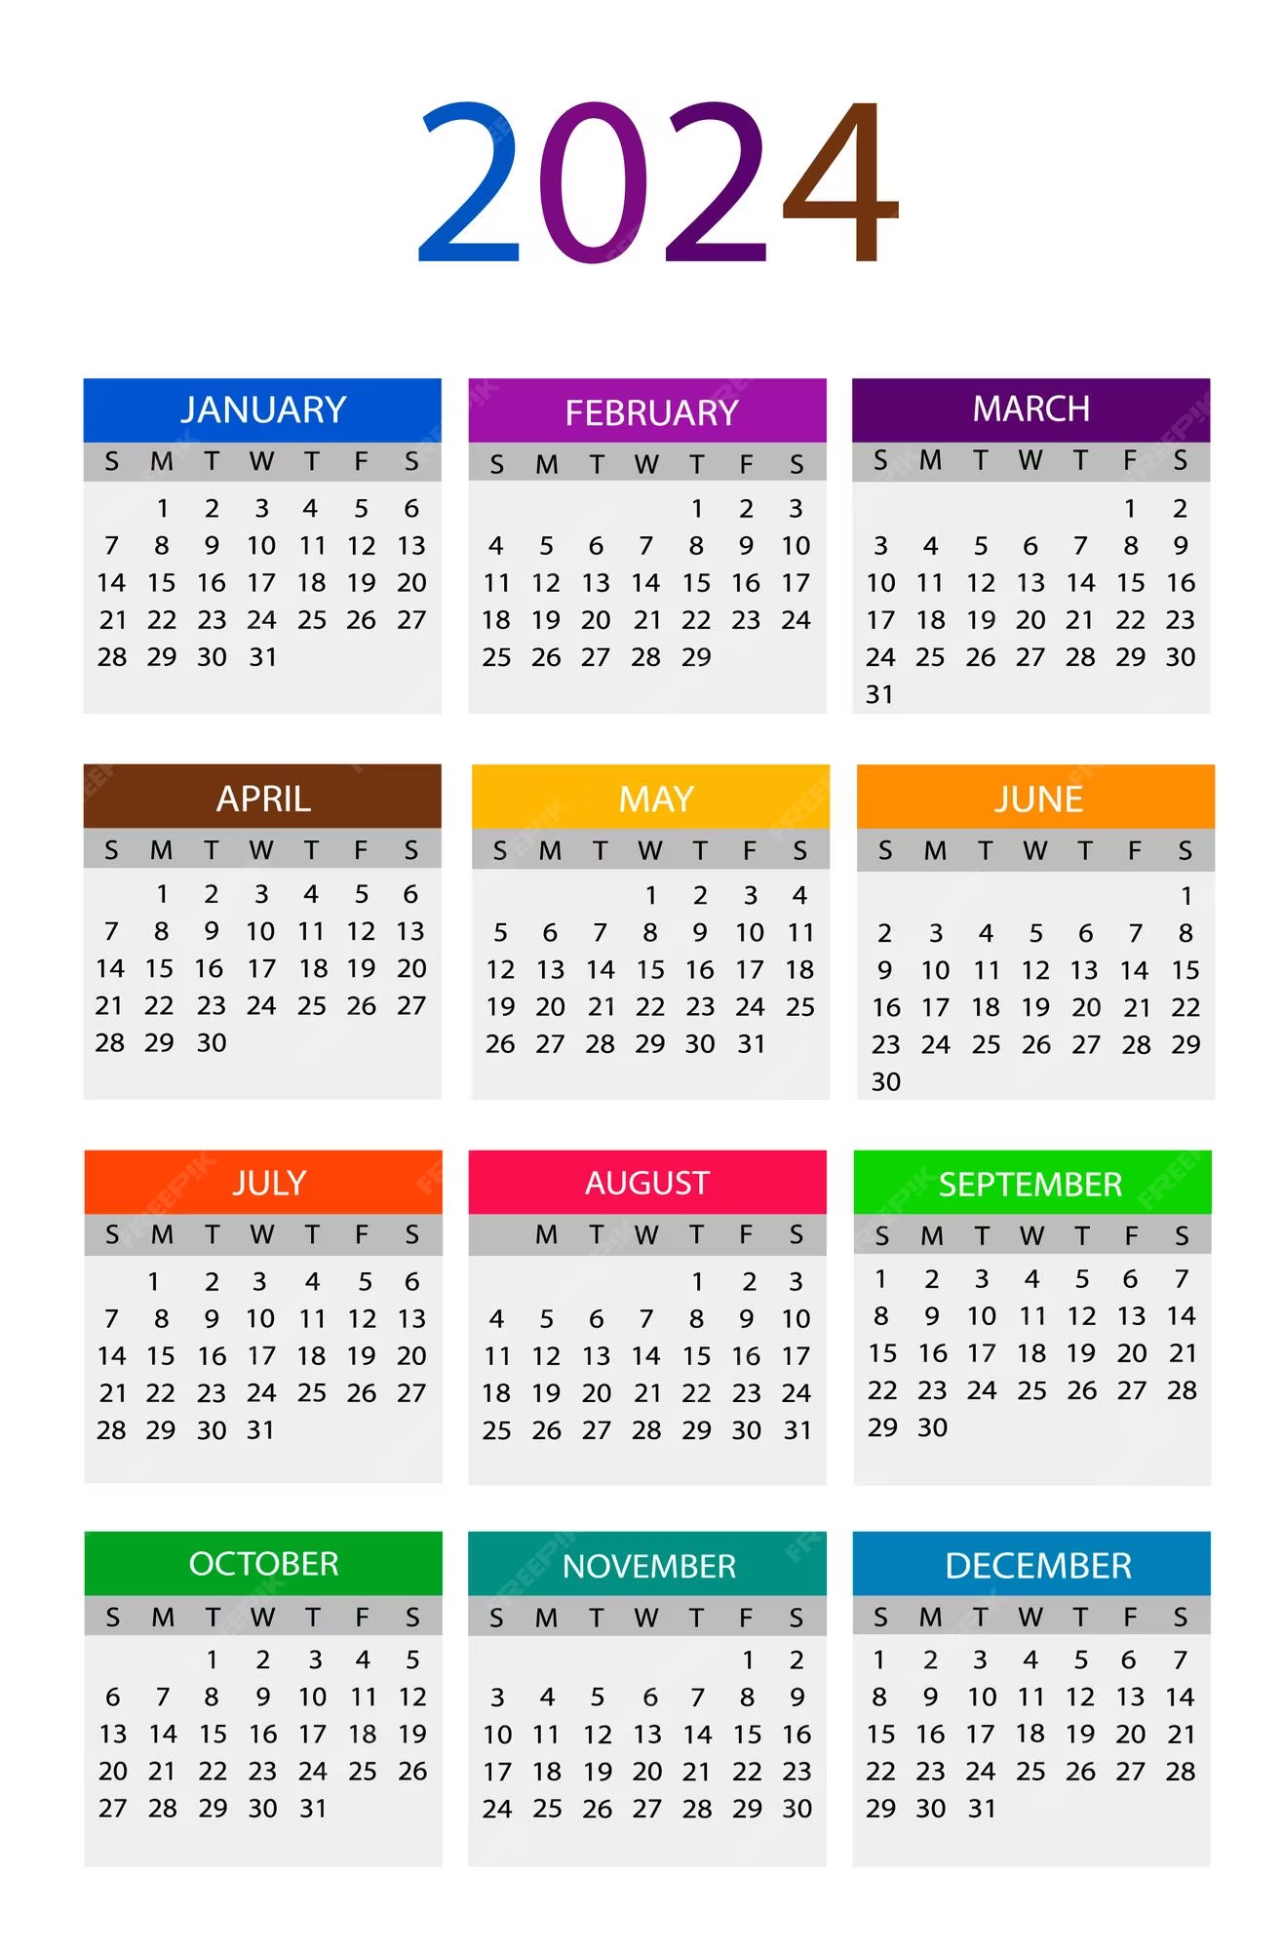
Key dates – Year 12
Date | To do ….
Wednesday 29th November 2023 | Parents work experience information evening
Friday 1st December | Work experience launch assembly
Friday 12th April 2024 | Year 12 – Final date for placement details to be submitted and consent form signed
17th to 21st June 2024 | Placement to be contacted by year 12 students
1st to 5th July 2024 | Work experience placement for year 12 students
8th July 2024 | Work experience debrief and feedback
"The kingdom of heaven is like a mustard seed... Though it is the smallest of all seeds, yet when it grows, it is the largest of garden plants and becomes a tree, so that the birds come and perch in its branches." Matthew 13 31-32

Slide 11
Key dates – Year 10
Date | To do ….
Friday 24th November | Year 11 work Experience Assembly and letters handed out
Wednesday 29th November | Parents work experience information evening
Friday 24th May | Final date for placement details to be submitted and consent form signed
1st to 12th July | Placement to be contacted by student
4th to 6th September | Students to complete placements
Monday 9th September | Work experience debrief and feedback
"The kingdom of heaven is like a mustard seed... Though it is the smallest of all seeds, yet when it grows, it is the largest of garden plants and becomes a tree, so that the birds come and perch in its branches." Matthew 13 31-32

Slide 12


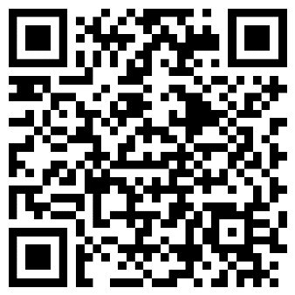
Please complete this form so that I have a central register of all details.
Once you have found a placement, please complete this form.
https://forms.office.com/e/bPmTfbpPnX?origin=lprLink
"The kingdom of heaven is like a mustard seed... Though it is the smallest of all seeds, yet when it grows, it is the largest of garden plants and becomes a tree, so that the birds come and perch in its branches." Matthew 13 31-32

Slide 13


During the placement, students will be expected to complete a Work Experience diary, recording their learning experiences.
On their return to school, students will undergo a full debrief of the weeks, sharing their experiences with others and evaluating the learning outcomes.
"The kingdom of heaven is like a mustard seed... Though it is the smallest of all seeds, yet when it grows, it is the largest of garden plants and becomes a tree, so that the birds come and perch in its branches." Matthew 13 31-32

Slide 14


If you do have any questions at all, please come and see me in the work/world zone office.
Or email me at: s.thomas@kingswolverhampton.co.uk/wex@kingswolverhampton.co.uk
If you can offer a work experience placement or know of anyone/business/organisation who can offer a placement please contact me using the details found here.
"The kingdom of heaven is like a mustard seed... Though it is the smallest of all seeds, yet when it grows, it is the largest of garden plants and becomes a tree, so that the birds come and perch in its branches." Matthew 13 31-32

